Slide 1
Data 102: Data, Inference, and Decisions
Lecture 1
Michael Jordan
University of California, Berkeley

Slide 2

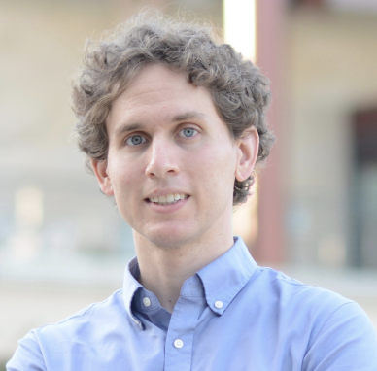
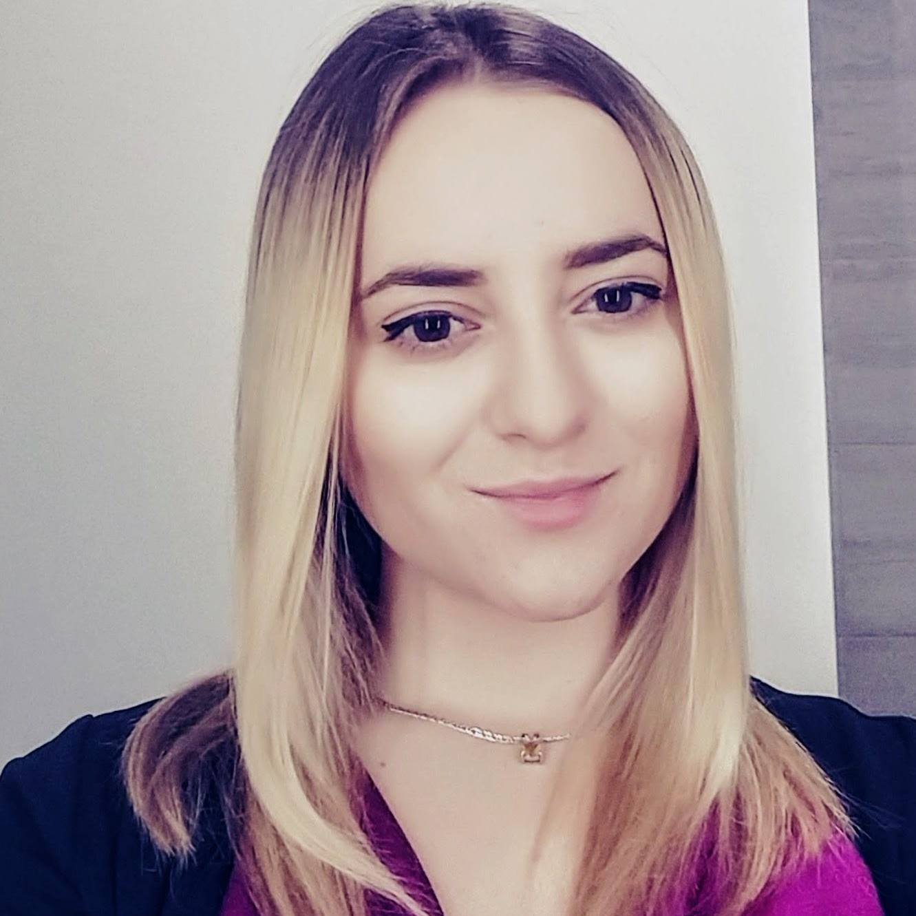



DS 102 team this semester
Jacob
Steinhardt
Mihaela Curmei
Jake Soloff
Yimeng Wang
Clara Wong-Fannjiang
Banghua Zhu
Building on work by Moritz Hardt, Fernando Perez, and the Fall 2019 and Spring 2020 teams.

Slide 3
Announcements
All class discussion on Piazza. Please be respectful and community-oriented.
TAs and faculty will not answer questions by email. Available via Piazza/Labs/Office hours.
Enrollment cap of 250 is firm. Instructors cannot change anything about that.
There is no course textbook, and lectures are of particular importance. (Watch them twice!)
Email ds-enrollments@berkeley.edu for enrollment related questions.

Slide 4
Data Science: A Personal Perspective
It arose both in science and in technology, over many decades
in science as the “fourth paradigm” or “data-intensive science”
in technology as new business models based on data flows and data analysis
in my view, it’s the latter which is the more strikingly era-defining phenomenon
Historical points of reference: the development of chemical engineering, civil engineering, and electrical engineering
in each case, real-world use cases combined with basic capabilities led to general principles and eventually to academic disciplines
we’re currently in the early days of the development of a new, human-centric form of engineering
Engineering means “real-world systems that work and deliver value to humans”
we have a lot of work to do to realize that promise in this new emerging field

Slide 5
Still Further Perspective
How does “Data Science” relate to “Machine Learning” and to “Artificial Intelligence”?
The phrase “Machine Learning” arose in the early 1980’s
the idea was that instead of programming computers, we would let them learn from experience, somewhat like humans and animals
the actual methods and concepts developed in the field are clearly related to, if not identical to, those of statistical inference and decision theory
I think of Machine Learning as the engineering side of Statistics (treating “engineering” with reverence)
on the next slide, see my industry-centric history of Machine Learning

Slide 6
Machine Learning in Industry
First Generation (‘90-’00): the backend
e.g., fraud detection, search, supply-chain management
Second Generation (‘00-’10): the human side
e.g., recommendation systems, commerce, social media
Third Generation (‘10-now): pattern recognition
e.g., speech recognition, computer vision, translation

Slide 7
Machine Learning in Industry
First Generation (‘90-’00): the backend
e.g., fraud detection, search, supply-chain management
Second Generation (‘00-’10): the human side
e.g., recommendation systems, commerce, social media
Third Generation (‘10-now): pattern recognition
e.g., speech recognition, computer vision, translation
Fourth Generation (emerging): markets
not just one agent making a decision or sequence of decisions
but a huge interconnected web of data, agents, decisions
many new challenges!

Slide 8
Machine Learning in Industry
First Generation (‘90-’00): the backend
e.g., fraud detection, search, supply-chain management
Second Generation (‘00-’10): the human side
e.g., recommendation systems, commerce, social media
Third Generation (‘10-now): pattern recognition
e.g., speech recognition, computer vision, translation
Fourth Generation (emerging): markets
not just one agent making a decision or sequence of decisions
but a huge interconnected web of data, agents, decisions
many new challenges!
What about “AI”?

Slide 9
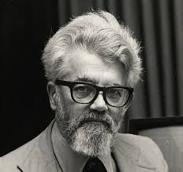
Perspectives on AI*
The classical “human-imitative” aspiration
*M. I. Jordan, Artificial Intelligence: The Revolution Hasn’t
Happened Yet, Medium, 2019

Slide 10
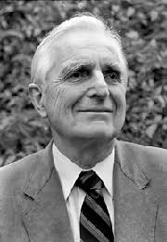
Perspectives on AI*
The classical “human-imitative” aspiration
The “intelligence augmentation” (IA) perspective
*M. I. Jordan, Artificial Intelligence: The Revolution Hasn’t
Happened Yet, Medium, 2019

Slide 11
Perspectives on AI*
The classical “human-imitative” aspiration
The “intelligence augmentation” (IA) perspective
The “intelligent infrastructure” (II) perspective
*M. I. Jordan, Artificial Intelligence: The Revolution Hasn’t
Happened Yet, Medium, 2019

Slide 12
Pattern Recognition
The third generation of Machine Learning has focused on supervised learning (aka, classification and regression)
labeled training data are used to train huge neural networks, via some form of gradient descent
this has traditionally been called pattern recognition
This has been a major success, yielding human-level performance in speech recognition and computer vision
and has yielded super-human-level performance in some tasks
Pattern recognition has become a commodity
companies are springing up worldwide to hire humans to provide labels for all kinds of data, transferring some aspects of human pattern recognition skill to computers

Slide 13
Decision Making
Is pattern recognition (or classification/regression) all there is?
The overall goal of a learning system is generally to make a decision of some kind
Is decision making merely a matter of setting an appropriate threshold on the output of a neural network, if the training data is good enough?
Let’s do a thought experiment

Slide 14
A Visit to the Doctor’s Office
Consider a medical checkup in the not-too-distant future, where the doctor measures thousands of physiological variables and even obtains your genome
This massive data vector is then input to a massive neural network, which has been trained to predict disease
Suppose that one of the outputs has been trained to predict kidney failure, with a value over 0.7 suggesting an imminent failure
Your value is 0.701
The neural network has “decided” that you’re in trouble-–what do you actually do?

Slide 15
A Visit to the Doctor’s Office
You will probably want to engage in a dialog, hopefully with a human but perhaps with the machine
You will want to know:
what are the error bars on that 0.701?
what kind of uncertainty is being captured by those error bars?
what is the provenance of the data; i.e., what subset of humans was it taken from, on what measuring devices, how long ago, and under what conditions?
given this provenance, how relevant is that prediction of 0.701 to me?
You will want to ask things like:
are you aware of certain facts about my history, my family, etc?
what if I were to exercise more, eat better, etc?
what are my treatment options, what are their costs, etc?
can I get a second opinion?

Slide 16
Decisions and Context
Real-world decisions with consequences
counterfactuals, provenance, relevance, causal inference, dialog
Sets of decisions across a network
false-discovery rate (instead of sensitivity/specificity/accuracy)
Sets of decisions across a network over time
streaming, asynchronous decisions
Decisions when there is scarcity and competition
need for an economic perspective
Decisions which affect future data and future decisions
need for a dynamical-systems, control-theoretic perspective
Decisions when there are consequences for others
need for an ethical perspective

Slide 17
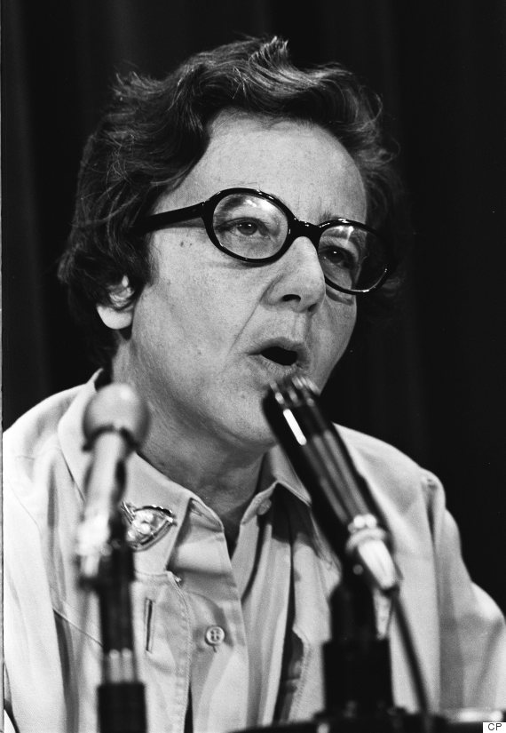
“[T]echnologies are developed and used within a particular social, economic, and political context. They arise out of a social structure, they are grafted on to it, and they may reinforce it or destroy it, often in ways that are neither foreseen nor foreseeable.”
Ursula Franklin, 1989

Slide 18
“[C]ontext is not a passive medium but a dynamic counterpart. The responses of people, individually, and collectively, and the responses of nature are often underrated in the formulation of plans and predictions.”
Ursula Franklin, 1989

Slide 19
Data 102
Unusually, this course will focus more on decision making and less on pattern recognition
Decision-oriented topics that we’ll cover include false-discovery rate control, bandit algorithms, causal inference, experimental design, matching markets, and reinforcement learning
This set of topics spills over from statistics into economics, game theory, and control theory
It will include discussion of incentives and unwanted outcomes

Slide 20
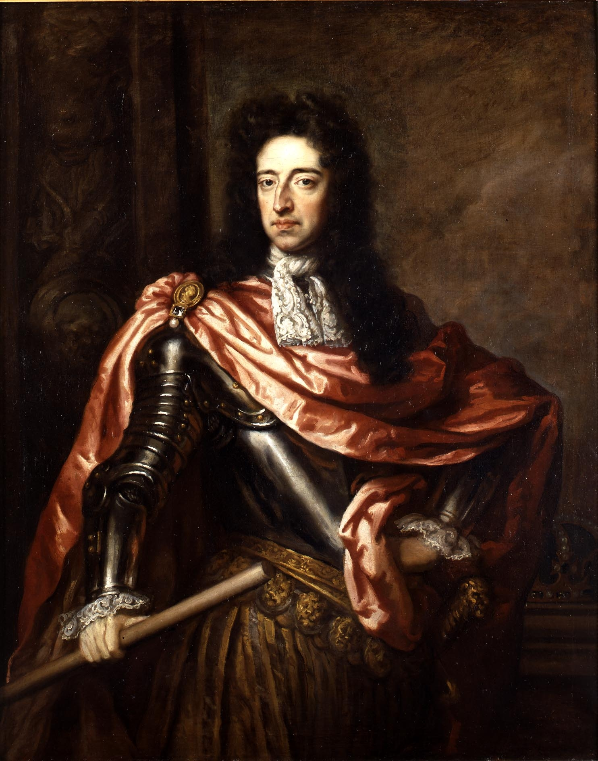
Early example of dynamics in decision making
In 1696, England's King William III seeks to tax wealth, but how to know one’s wealth?
Introduces tax based on number of windows
Idea spreads to France, Spain, Scotland

Slide 21
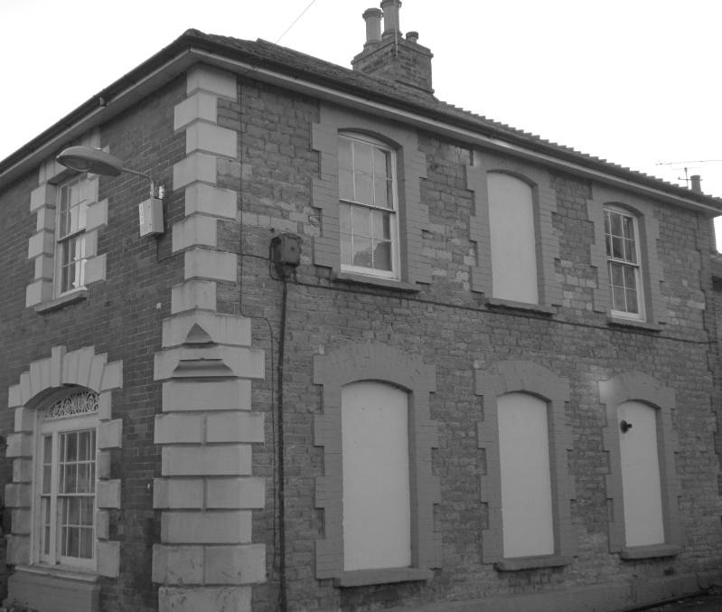
People adapt
One row of houses in Edinburgh featured no bedroom windows at all.
Tax revenues fell
Notes:
France kept window tax until 1926

Slide 22
Goodhart’s law
“Any observed statistical regularity will tend to collapse once pressure is placed upon it for control purposes.” - Charles Goodhart, 1975
Related:
Lucas critique 1976 in macroeconomics
Campbell’s law 1979 in social sciences

Slide 23
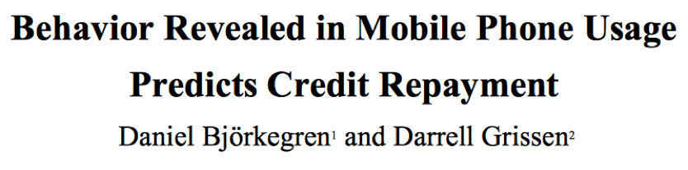
Learning invites gaming
Correlation is all you need for prediction
Typically lots of features
Features often easy to change
Features
Number of outgoing calls
Text response rate
Average airtime balance
Entropy of GPS coordinates

Slide 24

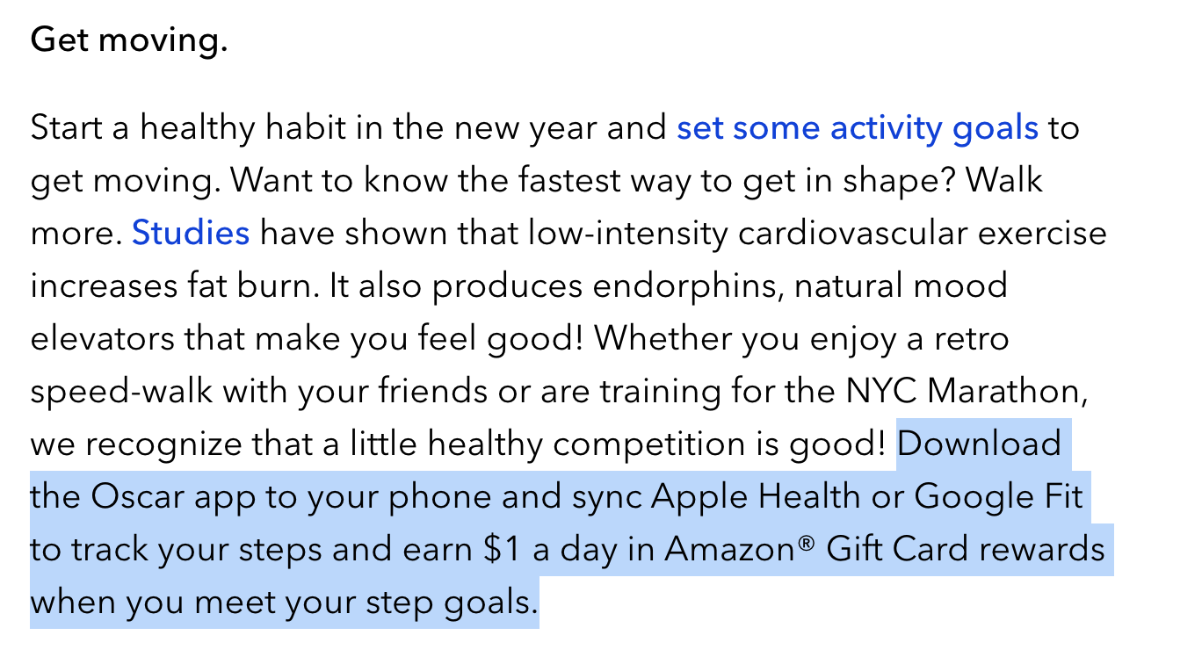
What behavior do our decisions incentivize?
https://www.hioscar.com/faq/five-ways-to-have-your-healthiest-year-yet

Slide 25


But there are two ways of going about it

Slide 26
Basics of Decision Making
We’ll start by considering the most simple of decision-making formulations
Let’s suppose that Reality is in one of two states, which we denote as 0 or 1
We don’t observe this state, but we do obtain Data that is drawn from a distribution that depends whether the state is 0 or 1
We make a Decision based on the Data, which we denote as 0 or 1
We can think of the Decision as our best guess as to the state of Reality or, more generally, as an action we think is best given our guess of the state of Reality
Example: COVID-19 testing

Slide 27
The Basic Two-by-Two Table
Decision
0
1
0
Reality
1

Slide 28
The Basic Two-by-Two Table
Decision
0
1
TN | FP
FN | TP
TN = True Negative
0
FP = False Positive
Reality
FN = False Negative
1
FP = True Positive

Slide 29
The Basic Two-by-Two Table
Decision
0
1
TN | FP
FN | TP
TN = True Negative
0
FP = False Positive
Reality
FN = False Negative
1
FP = True Positive

Slide 30
The Basic Two-by-Two Table
Decision
0
1
TN | FP
FN | TP
TN = True Negative
0
FP = False Positive
Reality
FN = False Negative
1
FP = True Positive

Slide 31
The Basic Two-by-Two Table
Decision
0
1
TN | FP
FN | TP
TN = True Negative
0
FP = False Positive
Reality
FN = False Negative
1
FP = True Positive
Rough goal: lots of green outcomes, few red outcomes!

Slide 32
Examples: How Serious are FP and FN (and How Desirable are TP and TN)?
Medical: 0 = no disease, 1 = disease
Commerce: 0 = no fraud, 1 = fraud
Physics: 0 = no Higgs boson, 1 = Higgs boson
Social network: 0 = no link, 1 = link
Self-driving car: 0 = no pedestrian, 1 = pedestrian
Search: 0 = not relevant, 1 = relevant
Oil-Well Drilling: 0 = no oil, 1 = oil

Slide 33
Examples: How Serious are FP and FN (and How Desirable are TP and TN)?
Medical: 0 = no disease, 1 = disease
Commerce: 0 = no fraud, 1 = fraud
Physics: 0 = no Higgs boson, 1 = Higgs boson
Social network: 0 = no link, 1 = link
Self-driving car: 0 = no pedestrian, 1 = pedestrian
Search: 0 = not relevant, 1 = relevant
Oil-Well Drilling: 0 = no oil, 1 = oil
In real-world domains, there are many, many complications that arise

Slide 34
Towards a Statistical Framework
Although the two-by-two table is useful conceptually, it’s not clear how to make use of it in a real problem, because we don’t know Reality
We need to move towards a statistical framework, where we consider not just one decision, but a set of related decisions

Slide 35
Towards a Statistical Framework
Let’s now imagine that we not only make a decision, but we build a decision-making algorithm
We want to evaluate the algorithm not just on one problem, but on a set of related problems

Slide 36
Towards a Statistical Framework
Let’s now imagine that we not only make a decision, but we build a decision-making algorithm
We want to evaluate the algorithm not just on one problem, but on a set of related problems
Concretely, we may have a collection of hypothesis-testing problems, where we repeatedly decide whether to accept the null or accept the alternative
Or we may have a set of classification decisions, where we repeatedly classify data points into one of two classes

Slide 37
Towards a Statistical Framework
Decision
0
1
0
Reality
1

Slide 38
Towards a Statistical Framework
Our language will start to involve rates and probabilities
Indeed, the variables , , , and are random variables
In just what sense they are random will need to be made clear (e.g., is the state of Reality random, is the Decision random, is random?)

Slide 39
Some Row-Wise Rates
Decision
0
1
0
Reality
1
sensitivity

Slide 40
Some Row-Wise Rates
Decision
0
1
0
Reality
1
aka, “true positive rate”
sensitivity
or “recall” or “power”

Slide 41
Some Row-Wise Rates
Decision
0
1
0
Reality
1
specificity

Slide 42
Some Row-Wise Rates
Decision
0
1
0
Reality
1
aka, “true negative rate”
specificity
or “selectivity”

Slide 43
Comments on the Row-Wise Rates
They can be thought of as estimates of conditional probabilities
e.g., sensitivity approximates

Slide 44
Comments on the Row-Wise Rates
They can be thought of as estimates of conditional probabilities
e.g., sensitivity approximates
As such, they are not dependent on the prevalence (i.e., the probabilities of the two states of Reality in the population)

Slide 45
Comments on the Row-Wise Rates
They can be thought of as estimates of conditional probabilities
e.g., sensitivity approximates
As such, they are not dependent on the prevalence (i.e., the probabilities of the two states of Reality in the population)
They are the kinds of quantities that are the focus of Neyman-Pearson inferential theory, which we’ll review in a moment
specificity = 1 – Type I error rate
sensitivity = 1 – Type II error rate = power

Slide 46
Towards Inference
We’d like to have have high sensitivity and high specificity
but in general there is a tradeoff (see whiteboard drawings)
we have to figure out how to manage the tradeoff

Slide 47
Towards Inference
We’d like to have have high sensitivity and high specificity
but in general there is a tradeoff (see whiteboard drawings)
we have to figure out how to manage the tradeoff
Neyman and Pearson (1932) formulated this problem as a constrained optimization problem:
maximize the sensitivity while constraining the specificity to be more than some fixed number (e.g., .95)
i.e., maximize the power while constraining the false-positive rate to be less than some fixed number (e.g., .05)
we’re neglecting the distinction between rates and probabilities here; we’ll be more clear on this later

Slide 48
A Tradeoff Curve (the “ROC curve”)
1
Threshold = 0
True positive rate
0
False positive rate
1
Threshold = 1

Slide 49
The Neyman-Pearson Formulation (1932)
Turn the problem into a constrained optimization problem:
maximize the power while constraining the false-positive rate to be under some fixed number (e.g., .05)
A very fruitful idea, and sometimes the right idea, but not to be viewed as written in stone

Slide 50
Some Column-Wise Rates
Decision
0
1
0
Reality
1
false omission rate

Slide 51
Some Column-Wise Rates
Decision
0
1
0
Reality
1
false discovery rate

Slide 52
Comments on the Column-Wise Rates
They can be thought of as estimates of conditional probabilities
e.g., false discovery rate approximates
They are dependent on the prevalence (i.e., the probabilities of the two states of Reality in the population), via Bayes’ Theorem
as such, they are more Bayesian
This is arguably a good thing, as we’ll see on the next slide

Slide 53
Type I error rate (per test) = 0.05
Run 10,000 different, independent
A/B tests
9,900 true nulls
495 false discoveries
“false discovery
rate” = 495/575
100 non-nulls
80 true discoveries
Power (per test) = 0.80

Slide 54
Type I error rate (per test) = 0.05
Run 10,000 different, independent
A/B tests
9,900 true nulls
495 false discoveries
“false discovery
rate” = 495/575
100 non-nulls
80 true discoveries
Power (per test) = 0.80
(NB: We’re again not being rigorous at this point; FDR is
actually an expectation of this proportion. We’ll do it right
anon.)

Slide 55
Back to Inference
Can we develop general frameworks that allow us to control column-wise quantities like the false-discovery rate (FDR)?
in a similar way as Neyman-Pearson controls the false-positive rate
To be continued…

